Slide 1
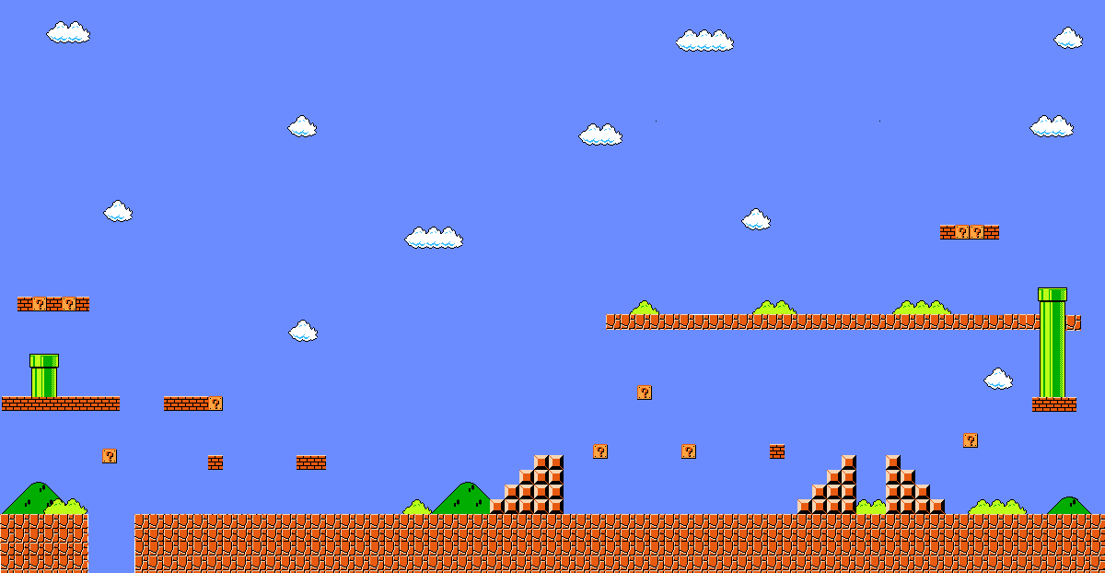
Play Your GAMES: Generating Academic Meaning from Entertainment Systems.
Tim Kubinak 6th Grade Mathematics; John Yeates MS
Suffolk, Virginia
https://twitter.com/mrkteachesstem

Slide 2
Play Your GAMES: Generating Academic Meaning from Entertainment Systems.
What is Play Your GAMES (PYG)?
Math
Gameplay
Science
Success
Technology
Engineering
Failure
Problem Solving
PYG is a gameplay program designed to exploit the interests of students, within the context of reinforcing STEM methodology and problem-solving acuity.
Tim Kubinak

Slide 3
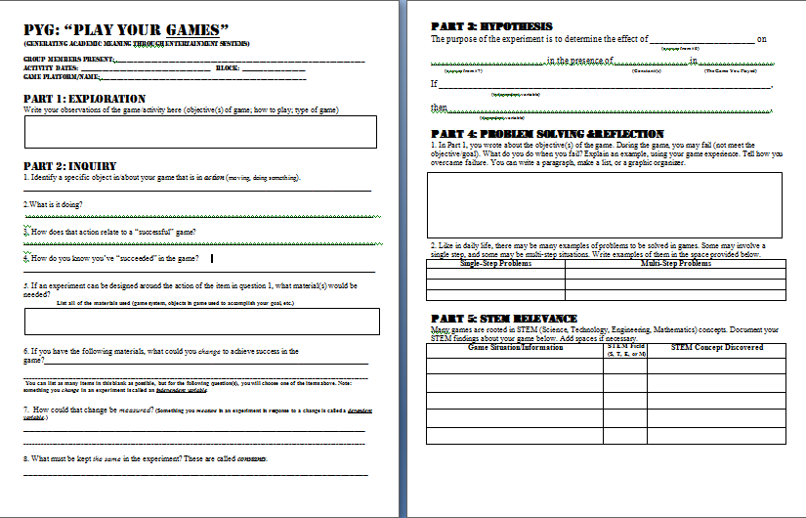
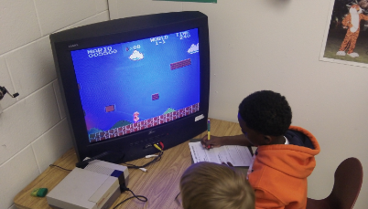
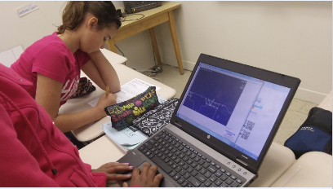
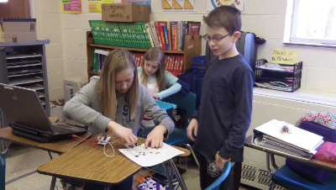
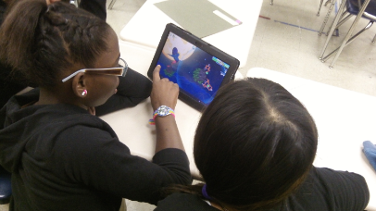
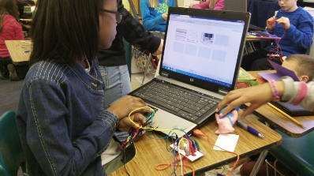
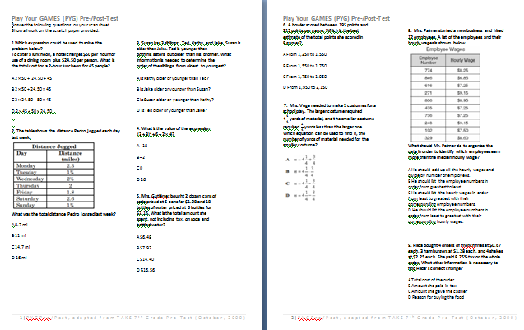
Play Your GAMES: Generating Academic Meaning from Entertainment Systems.
What Does PYG Look Like?
Tim Kubinak
Notes:
The video clip, 100_0586, is on the camera. Transfer it to the laptop, so it can be accessed. This may require reinserting it into the presentation for it to operate correctly.

Slide 4
Play Your GAMES: Generating Academic Meaning from Entertainment Systems.
Why Use PYG? (Objectives)
Teach/Model problem solving!
Engage students in STEM topics (regardless of content area)
Use gameplay to propel core content
Keep STEM learning/methodology at the forefront (due to scheduling needs, some districts schedule science/history courses as a semester course)
Exploit student interests to draw kids to core content
Tim Kubinak

Slide 5
Play Your GAMES: Generating Academic Meaning from Entertainment Systems.
Is It Research-Based?
Popular Media Exposure: • Wired Magazine- Kids Like to Learn Algebra, if It Comes in the Right App. http://wrd.cm/1f98hIZ
3 Reasons Your Kids Should Be Playing Video Games (Edutopia): http://t.co/yiS9TQkRUj
How online gamers are solving science's biggest problems. http://t.co/F7lm8KatFg
Game-based learning to teach STEM: http://t.co/rJQ55E2IOY
National STEM Video Game Challenge- http://bit.ly/1d2tW2m
In Academia:
Cultural Studies of Science Education: Leveraging insights from mainstream gameplay to inform STEM game design: great idea, but what comes next? http://bit.ly/1bNxURW
Marine Technology Society: D.E.E.P. Learning; Promoting Informal STEM Learning through Ocean Research Videogames. http://bit.ly/1nPieNN
Aligning Problem Solving and Gameplay: A Model for Future Research and Design. http://bit.ly/1gYkAJo
The Efficacy of Games and Simulations for Learning (Chapter): Educational Gameplay and Simulation Environments. http://bit.ly/1fiwMVh
Tim Kubinak

Slide 6
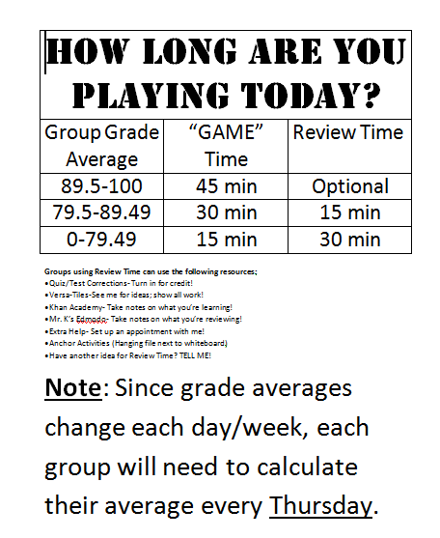
Play Your GAMES: Generating Academic Meaning from Entertainment Systems.
A Typical PYG Session…for Me
Thursday…7:25-7:35am
-PYG groups meet to discuss game platform/choice for week(s)
-Calculate group average, which determines time-in-gameplay
Tim Kubinak

Slide 7
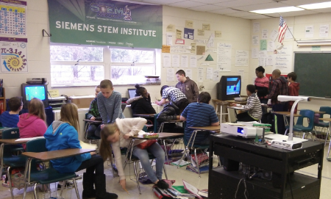
Play Your GAMES: Generating Academic Meaning from Entertainment Systems.
A Typical PYG Session…for Me
Friday…8:15-9:00am
-PYG groups meet to get game platform equipment and/or set up their own equipment for gameplay
-Obtain PYG sheet
-Play their chosen game for the timeframe determined by yesterday’s average calculation
Tim Kubinak

Slide 8
Play Your GAMES: Generating Academic Meaning from Entertainment Systems.
Efficacy/QA
Pre-/Post-Assessments: •Focus on problem-solving (single-step is emphasized in ES settings; test is primarily multistep word problems)
Adapted from the 2009 7th Grade TAKS (Texas Assessment of Knowledge & Skills; http://www.tea.state.tx.us/student.assessment/taks/released-tests/archive/
Tests administered September and May
Tim Kubinak

Slide 9
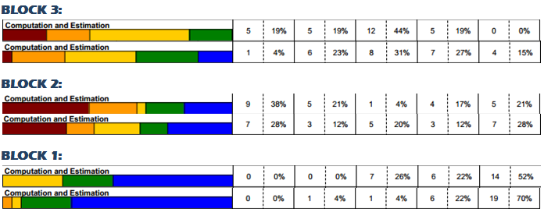
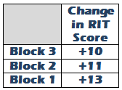
Play Your GAMES: Generating Academic Meaning from Entertainment Systems.
Efficacy/QA
Standardized Test Data Comparisons:
Measures of Academic Progress® (MAP®) Test- RIT scores assigned to measure growth, create progress goals (more info on RIT: http://bit.ly/Ni7s7A)
Fall, Winter Test Administrations (next test: May 2014)
Low | Low Avg | Avg | High Avg | High
Tim Kubinak
Notes:
Note: What are the RIT score ranges for each of the level categories? http://www.nwea.org/sites/www.nwea.org/files/resources/VA%202012%20Linking%20Study.pdf

Slide 10
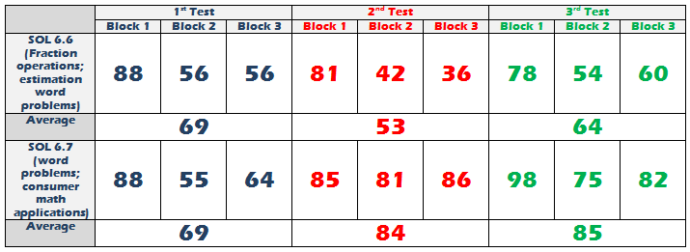
Play Your GAMES: Generating Academic Meaning from Entertainment Systems.
Efficacy/QA
Standardized Test Data Comparisons:
Local Assessment Data- SOL 6.6/6.7 (most approximate standards)
Tim Kubinak

Slide 11
Play Your GAMES: Generating Academic Meaning from Entertainment Systems.
Student Accountability
PYG Sheet-
Structured to guide students through gameplay as a scientific process, while also providing opportunity to see the game through a “STEM lens”
2. Time-In-Game Qualification-
Students qualify for their game time by academic achievement. All students are able to participate, but higher group averages equate to more game time. Groups with less game time use that free time to do review activities, remediation on previous assessments, and/or get peer tutoring.
3. BYOD!
4. Possible Add-Ons-
It is difficult to help the program “fresh” if you’re not scouting new opportunities/wrinkles to the program.
-Writing opportunities to further process gameplay
-Makey Makey kits (www.makeymakey.com)
-Game Design potential
Tim Kubinak

Slide 12
Play Your GAMES: Generating Academic Meaning from Entertainment Systems.
Challenges
BYOD-
-Dependent upon district policy, desire to make waves
-Increases the # of available inventory of games (see below)
2. “How do I fit this into my instructional practice?”
-A question to ask: “Do I want my kids to be good problem solvers?” “Do I want my kids to understand STEM methodology?”
-If you can tie this to a skillset that will be needed later in life AND/OR a prescribed standard(s), read on..
3. Free, Cheap, or Out-of-Pocket?
-Depending on funding/grant supports, or if you’re just rich, you may decide to purchase game licenses, systems, etc
-Keeping it free- games that can be accessed through district filters; BYOD; game platforms that can be obtained (ex. NES, PS2/3/4, etc)
4. Game Inventory
-Vetting of games is IMPORTANT! -Clearninghouse for vetted games (website, Drive, etc)
-”Is the game appropriate for use in the school setting?”
Tim Kubinak

Slide 13
Play Your GAMES: Generating Academic Meaning from Entertainment Systems.
Opportunities for Improvement
Preface: I (probably) don’t have all the answers.
Assessment- Using pre/post-testing to quantify problem-solving improvement (did not do this in first year of program)
BYOD- Though my district is just beginning to implement a BYOD policy, I have allowed students to use mobile devices for PYG (with caveats); game vetting will be a challenge at times, as students find new games.
PYG Sheet- Has gone through 3 revisions since last year, in an effort to maximize its value in STEM methodology, problem-solving process
Session Scheduling- Because the first job is ACADEMICS, not every week will be a PYG day; by maximizing my teaching time, and using technology in other ways, time can be made to keep the program a part of the instructional practice.
Tim Kubinak

Slide 14
Play Your GAMES: Generating Academic Meaning from Entertainment Systems.
What Would YOU Do?
Am I flexible enough in my instruction? Do my students need this?
What resources/support can I pull together?
How will I communicate this with stakeholders?
When will I do this?
How will I quantify any desired results?
Who can I collaborate with to make this a success?
Where can get more information about gameplay in the classroom?
Am I ready for kids to be EXCITED about ______ AND STEM!?
Tim Kubinak

Slide 15
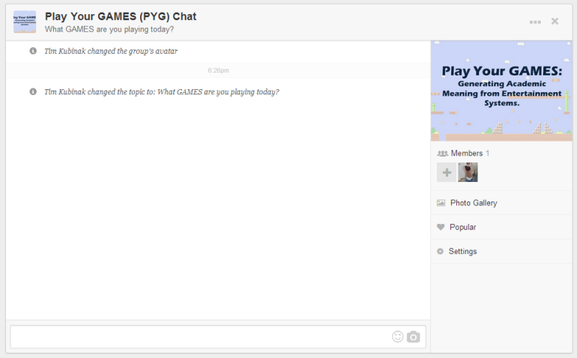
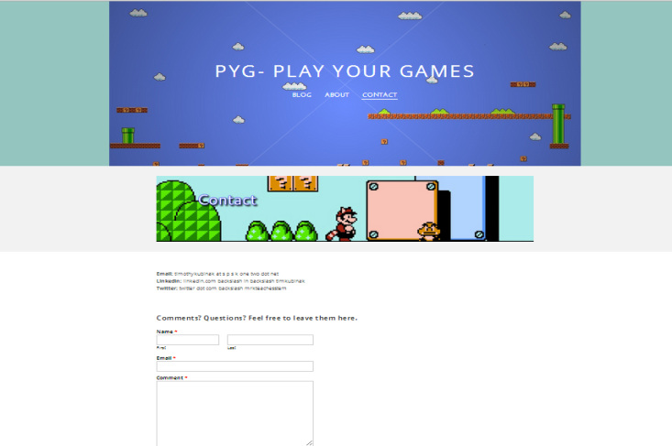
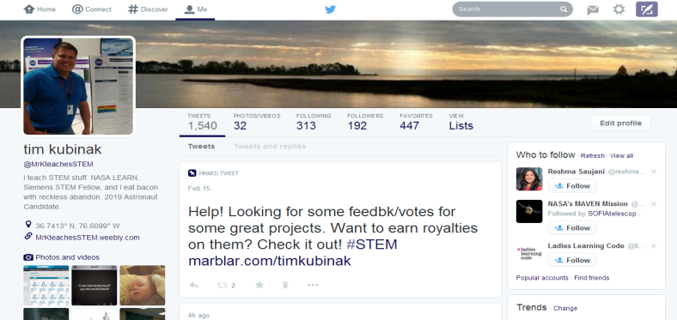
Play Your GAMES: Generating Academic Meaning from Entertainment Systems.
PYG Community
timothykubinak@spsk12.net
Join the GroupMe Chat!
(Sign up to be sent an invite)
Check out the PYG website! (games; news; events)
http://pyg.weebly.com
I tweet game ideas, resources, and research when I see it… @MrKteachesSTEM- Hashtag #PYG
Tim Kubinak

Slide 16
Play Your GAMES: Generating Academic Meaning from Entertainment Systems.
Acknowledgements:
The PYG project would not have been possible without the support of the following people/organizations. You should check them out.
VCTM/NCTM
DonorsChoose.org
Mr. Daniel O’Leary, Principal, JYMS
JYMS PTSA
My wife and kids
Background Credit: Deviant Art; http://tinyurl.com/mvx2two
Tim Kubinak

Slide 17
Play Your GAMES: Generating Academic Meaning from Entertainment Systems.
Tim Kubinak
6th Grade Mathematics
John Yeates Middle School
Suffolk, Virginia
Twitter: @MrKteachesSTEM
Web: http://MrKteachesSTEM.weebly.com
PYG: http://pyg.weebly.com
LinkedIn: Yes, I’m there
Google: Yes, you may Google me.
Bacon: Yes, please.
Tim Kubinak

